Slide 1

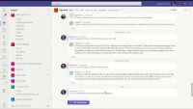
WORKFORCE OPTIMIZATION
Using Chatbots to Automate Information Gathering
Create Virtual Agents to Initiate Work Orders
Improved Customer Service: Chatbots and PVA can provide customers with quick and accurate responses to their queries, improving their overall experience and satisfaction.
Increased Efficiency: Chatbots and PVA can handle multiple customer inquiries simultaneously, reducing the workload for customer service representatives and freeing up their time to handle more complex queries.
24/7 Availability: Chatbots and PVA can be available 24/7, providing customers with support outside of regular business hours and reducing wait times.
Cost Savings: Chatbots and PVA can help reduce customer service costs by automating routine tasks and reducing the need for human intervention.
Power Virtual Agents + Asset Management

